Slide 1
Learning Objectives
Basic computer concepts.
The different types of programming languages.
The history of the C programming language.
The purpose of the C Standard Library.
The basics of object technology.
A typical C program development environment.

Slide 2
Hardware and Software (1 of 3)
Computers can perform calculations and make logical decisions phenomenally faster than human beings can.
Today’s personal computers can perform billions of calculations in one second—more than a human can perform in a lifetime.
Supercomputers are already performing thousands of trillions (quadrillions) of instructions per second!
Computers process data under the control of sequences of instructions called computer programs.
These programs guide the computer through ordered actions specified by people called computer programmers.

Slide 3
Hardware and Software (2 of 3)
The programs that run on a computer are referred to as software.
A computer consists of various devices referred to as hardware
  (e.g., the keyboard, screen, mouse, hard disks, memory, D V D drives and processing units).
Computing costs are dropping dramatically, owing to rapid developments in hardware and software technologies.

Slide 4
Hardware and Software (3 of 3)
Computers that might have filled large rooms and cost millions of dollars decades ago are now inscribed on silicon chips smaller than a fingernail, costing perhaps a few dollars each.
Silicon-chip technology has made computing so economical that computers have become commodity.

Slide 5
Moore’s Law (1 of 3)
For many decades, hardware costs have fallen rapidly.
Every year or two, the capacities of computers have approximately doubled inexpensively.
This trend often is called Moore’s Law, named for the person who identified it in the 1960s, Gordon Moore, co-founder of Intel.

Slide 6
Moore’s Law (2 of 3)
Moore’s Law and related observations apply especially to the amount of memory that computers have for programs, the amount of secondary storage (such as disk storage) they have to hold programs and data over longer periods of time, and their processor speeds—the speeds at which computers execute their programs (i.e., do their work).
Similar growth has occurred in the communications field.

Slide 7
Moore’s Law (3 of 3)
Costs have plummeted as enormous demand for communications bandwidth (i.e., information-carrying capacity) has attracted intense competition.
Such phenomenal improvement is fostering the Information Revolution.

Slide 8
Computer Organization
Regardless of differences in physical appearance, computers can be envisioned as divided into various logical units or sections (Figure 1)

Slide 9
Figure 1 Logical Units of a Computer (1 of 5)
Logical unit | Description
Input unit | This “receiving” section obtains information (data and computer programs) from input devices and places it at the disposal of the other units for processing. Most user input is entered into computers through keyboards, touch screens and mouse devices. Other forms of input include receiving voice commands, scanning images and barcodes, reading from secondary storage devices (such as hard drives, D V D drives, Blu-ray Disc™ drives and U S B flash drives—also called “thumb drives” or “memory sticks”), receiving video from a webcam and having your computer receive information from the Internet (such as when you stream videos from YouTube® or download e-books from Amazon). Newer forms of input include position data from a G P S device, and motion and orientation information from an accelerometer (a device that responds to up/down, left/right and forward/backward acceleration) in a smartphone or game controller (such as Microsoft® Kinect® for Xbox®, Wii™ Remote and Sony® PlayStation® Move).

Slide 10
Figure 1 Logical Units of a Computer (2 of 5)
Logical unit | Description
Output unit | This “shipping” section takes information the computer has processed and places it on various output devices to make it available for use outside the computer. Most information that’s output from computers today is displayed on screens (including touch screens), printed on paper (“going green” discourages this), played as audio or video on P C s and media players (such as Apple’s iPods) and giant screens in sports stadiums, transmitted over the Internet or used to control other devices, such as robots and “intelligent” appliances. Information is also commonly output to secondary storage devices, such as hard drives, D V D drives and U S B flash drives. Popular recent forms of output are smartphone and game controller vibration, and virtual reality devices like Oculus Rift.

Slide 11
Figure 1 Logical Units of a Computer (3 of 5)
Logical unit | Description
Memory unit | This rapid-access, relatively low-capacity “warehouse” section retains information that has been entered through the input unit, making it immediately available for processing when needed. The memory unit also retains processed information until it can be placed on output devices by the output unit. Information in the memory unit is volatile—it’s typically lost when the computer’s power is turned off. The memory unit is often called either memory, primary memory or RAM (Random Access Memory). Main memories on desktop and notebook computers contain as much as 128 G B of RAM, though 2 to 16 G B is most common. G B stands for gigabytes; a gigabyte is approximately one billion bytes. A byte is eight bits. A bit is either a 0 or a 1.

Slide 12
Figure 1 Logical Units of a Computer (4 of 5)
Logical unit | Description
Arithmetic and logic unit (A L U) | This “manufacturing” section performs calculations, such as addition, subtraction, multiplication and division. It also contains the decision mechanisms that allow the computer, for example, to compare two items from the memory unit to determine whether they’re equal. In today’s systems, the A L U is implemented as part of the next logical unit, the C P U.
Central processing unit (C P U) | This “administrative” section coordinates and supervises the operation of the other sections. The C P U tells the input unit when information should be read into the memory unit, tells the A L U when information from the memory unit should be used in calculations and tells the output unit when to send information from the memory unit to certain output devices. Many of today’s computers have multiple C P Us and, hence, can perform many operations simultaneously. A multi-core processor implements multiple processors on a single integrated-circuit chip—a dual-core processor has two C P U s and a quadcore processor has four C P Us. Today’s desktop computers have processors that can execute billions of instructions per second.

Slide 13
Figure 1 Logical Units of a Computer (5 of 5)
Logical unit | Description
Secondary storage unit | This is the long-term, high-capacity “warehousing” section. Programs or data not actively being used by the other units normally are placed on secondary storage devices (e.g., your hard drive) until they’re again needed, possibly hours, days, months or even years later. Information on secondary storage devices is persistent—it’s preserved even when the computer’s power is turned off. Secondary storage information takes much longer to access than information in primary memory, but its cost per unit is much less. Examples of secondary storage devices include hard drives, D V D drives and U S B flash drives, some of which can hold over 2 T B (TB stands for terabytes; a terabyte is approximately one trillion bytes). Typical hard drives on desktop and notebook computers hold up to 2 T B, and some desktop hard drives can hold up to 6 T B.

Slide 14
Data Hierarchy (1 of 6)
Data items processed by computers form a data hierarchy that becomes larger and more complex in structure as we progress from bits to characters to fields, and so on.

Slide 15
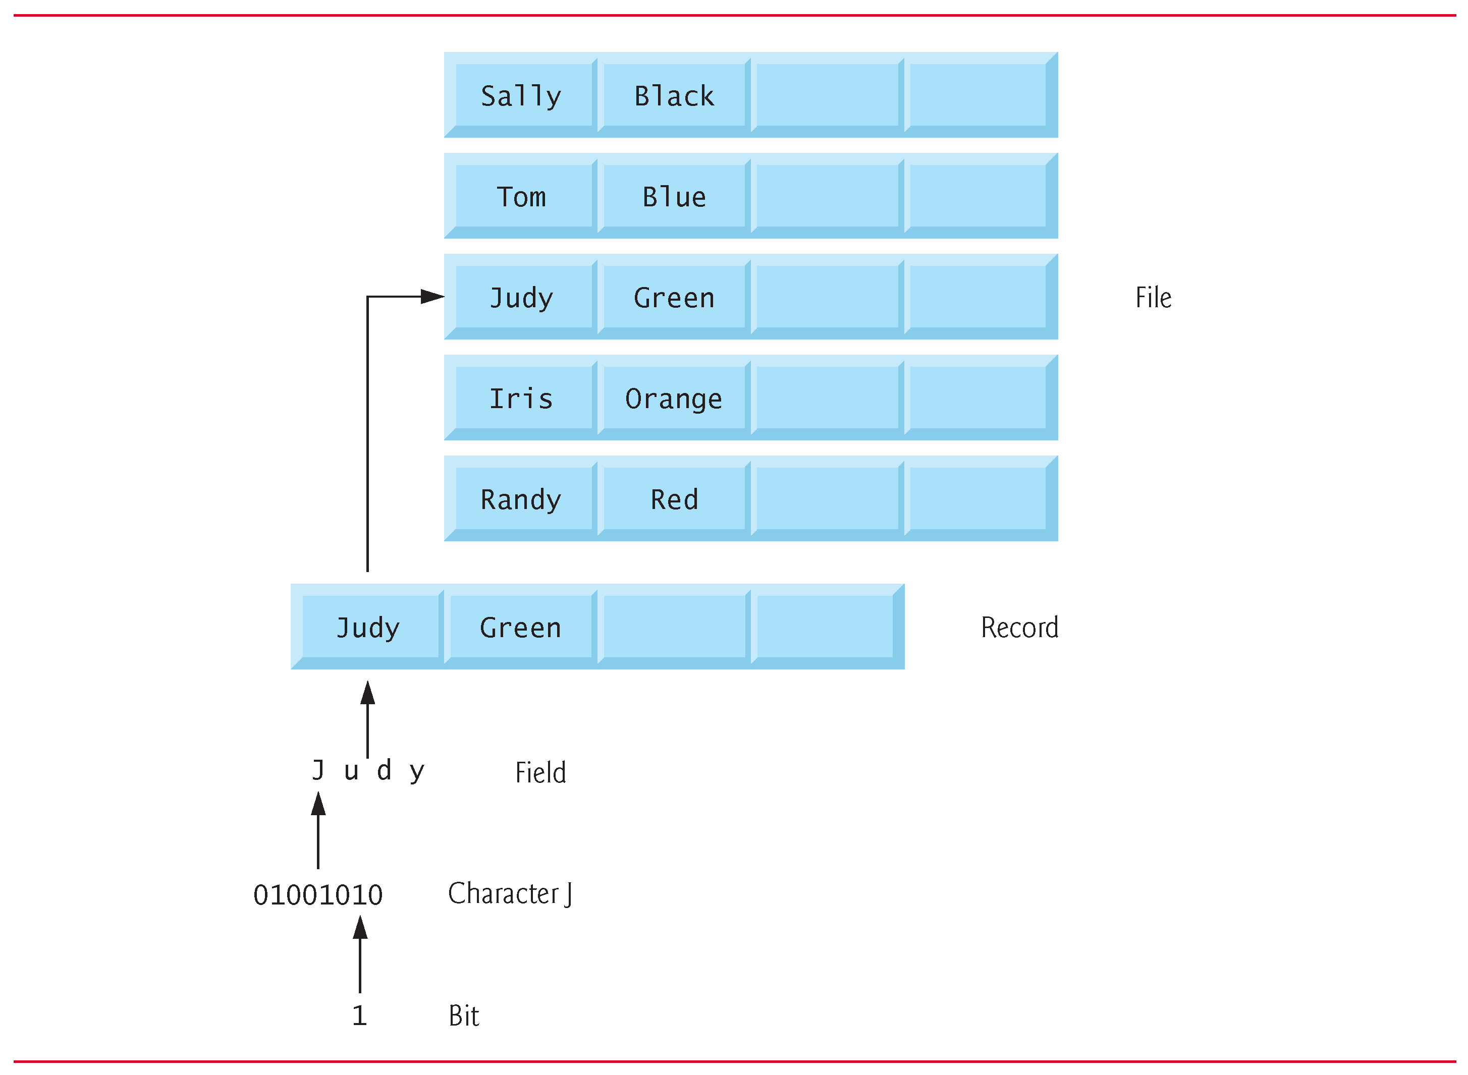
Figure 2 Data Hierarchy

Slide 16
Data Hierarchy (2 of 6)
Bits
  The smallest data item in a computer can assume the value 0 or the value 1.
  Short for “binary digit”—a digit that can assume one of two values.
Characters
  It’s tedious for people to work with data in the low-level form of bits

Slide 17
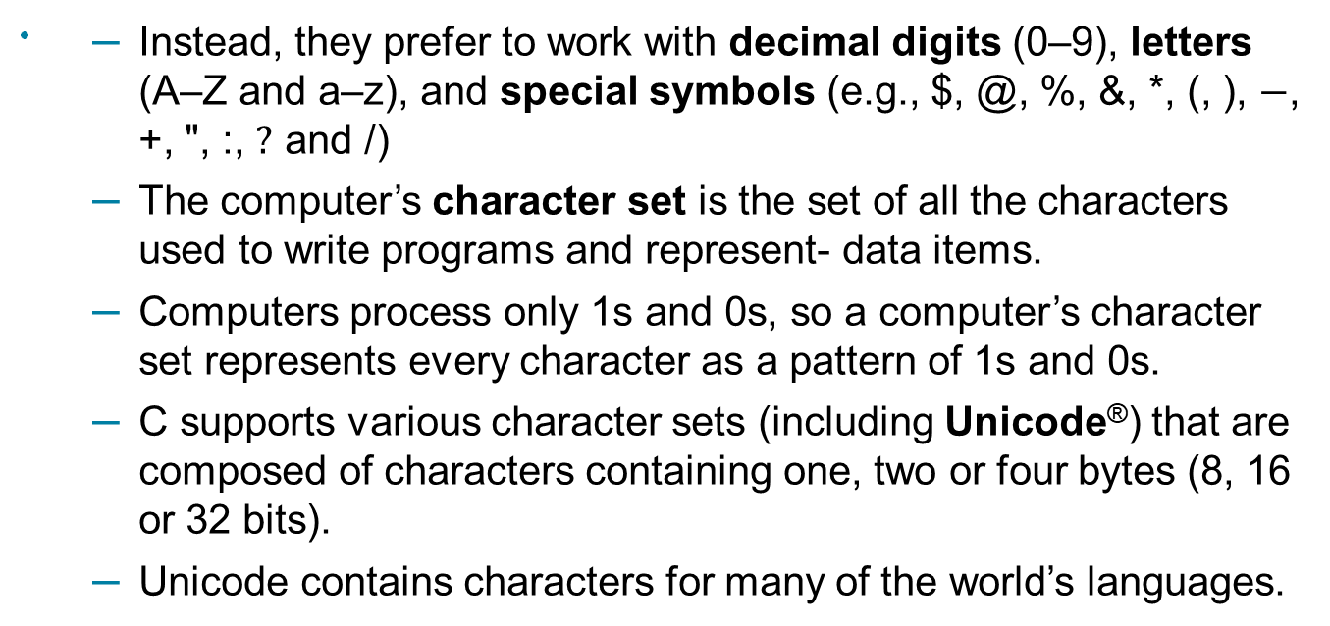
Data Hierarchy (3 of 6)

Slide 18
Data Hierarchy (4 of 6)
Fields
  Composed of characters or bytes.
  A field is a group of characters or bytes that conveys meaning.
Records
  Several related fields can be used to compose a record—a group of related fields.

Slide 19
Data Hierarchy (5 of 6)
File
  A group of related records.
  More generally, a file contains arbitrary data in arbitrary formats.
  In some operating systems, a file is viewed simply as a sequence of bytes—any organization of the bytes in a file, such as organizing the data into records, is a view created by the application programmer.
Database
  A database is a collection of data organized for easy access and manipulation.

Slide 20
Data Hierarchy (6 of 6)
  The most popular model is the relational database, in which data is stored in simple tables.
  A table includes records and fields.
  You can search, sort and otherwise manipulate the data based on its relationship to multiple tables or databases.
Big Data
  According to I B M, approximately 2.5 quintillion bytes (2.5 exabytes) of data are created daily and 90% of the world’s data was created in just the past two years
  According to an I D C study, the global data supply will reach 40 zettabytes (equal to 40 trillion gigabytes) annually by 2020.
  Big data applications deal with massive amounts of data

Slide 21







Figure 3 Byte Measurements
Unit | Bytes | Which is approximately
1 kilobyte (K B) | 1024 bytes | 10 power 3 (1024 bytes exactly)
1 megabyte (M B) | 1024 kilobytes | 10 power 6 (1,000,000 bytes)
1 gigabyte (G B) | 1024 megabytes | 10 power 9 (1,000,000,000 bytes)
1 terabyte (T B) | 1024 gigabytes | 10 power 12 (1,000,000,000,000 bytes)
1 petabyte (P B) | 1024 terabytes | 10 power 15 (1,000,000,000,000,000 bytes)
1 exabyte (E B) | 1024 petabytes | 10 power 18 (1,000,000,000,000,000,000 bytes)
1 zettabyte (Z B) | 1024 exabytes | 10 power 21 (1,000,000,000,000,000,000,000 bytes)

Slide 22
Machine Languages, Assembly Languages and High-Level Languages (1 of 3)
Programmers write instructions in various programming languages, some directly understandable by computers and others requiring intermediate translation steps.
Any computer can directly understand only its own machine language, defined by its hardware design.
Machine languages generally consist of numbers (ultimately reduced to 1s and 0s). Such languages are cumbersome for humans.
Programming in machine language—the numbers that computers could directly understand—was simply too slow and tedious for most programmers.
Instead, they began using English like abbreviations to represent elementary operations.

Slide 23
Machine Languages, Assembly Languages and High-Level Languages (2 of 3)
These abbreviations formed the basis of assembly languages.
Translator programs called assemblers were developed to convert assembly-language programs to machine language.
Although assembly-language code is clearer to humans, it’s incomprehensible to computers until translated to machine language.
To speed the programming process even further, high-level languages were developed in which single statements could be written to accomplish substantial tasks.
High-level languages allow you to write instructions that look almost like everyday English and contain commonly used mathematical expressions.

Slide 24
Machine Languages, Assembly Languages and High-Level Languages (3 of 3)
Translator programs called compilers convert high-level language programs into machine language.
Interpreter programs were developed to execute high-level language programs directly, although more slowly than compiled programs.
Scripting languages such as JavaScript and P H P are processed by interpreters.

Slide 25
The C Programming Language (1 of 3)
C evolved from two previous languages, B C P L and B.
B C P L was developed in 1967 by Martin Richards as a language for writing operating-systems software and compilers.
Ken Thompson modeled many features in his B language after their counterparts in B C P L, and in 1970 he used B to create early versions of the UNIX operating system at Bell Laboratories.

Slide 26
The C Programming Language (2 of 3)
The C language was evolved from B by Dennis Ritchie at Bell Laboratories and was originally implemented in 1972.
C initially became widely known as the development language of the UNIX operating system.
Many of todays leading operating systems are written in C and/or C++.
C is mostly hardware independent.
With careful design, it’s possible to write C programs that are portable to most computers.

Slide 27
The C Programming Language (3 of 3)
Built for Performance
C is widely used to develop systems that demand performance, such as operating systems, embedded systems, real-time systems and communications systems (Figure 1.4).

Slide 28
Figure 4 Some Popular Performance-Oriented C Applications (1 of 2)
Application | Description
Operating systems | C’s portability and performance make it desirable for implementing operating systems, such as Linux and portions of Microsoft’s Windows and Google’s Android. Apple’s O S X is built in Objective-C, which was derived from C. We discuss some key popular desktop/notebook operating systems and mobile operating systems in Section 1.11.
Embedded systems | The vast majority of the microprocessors produced each year are embedded in devices other than general-purpose computers. These embedded systems include navigation systems, smart home appliances, home security systems, smartphones, tablets, robots, intelligent traffic intersections and more. C is one of the most popular programming languages for developing embedded systems, which typically need to run as fast as possible and conserve memory. For example, a car’s antilock brakes must respond immediately to slow or stop the car without skidding; game controllers used for video games should respond instantaneously to prevent any lag between the controller and the action in the game, and to ensure smooth animations.

Slide 29
Figure 4 Some Popular Performance-Oriented C Applications (2 of 2)
Application | Description
Real-time systems | Real-time systems are often used for “mission-critical” applications that require nearly instantaneous and predictable response times. Real-time systems need to work continuously for example, an air-traffic-control system must constantly monitor the positions and velocities of the planes and report that information to air-traffic controllers without delay so that they can alert the planes to change course if there’s a possibility of a collision.
Communications systems | Communications systems need to route massive amounts of data to their destinations quickly to ensure that things such as audio and video are delivered smoothly and without delay.

Slide 30
Portability Tip 1.1
Because C is a hardware-independent, widely available language, applications written in C often can run with little or no modification on a wide range of computer systems.

Slide 31
C Standard Library (1 of 3)
As you’ll learn later , C programs consist of pieces called functions.
You can program all the functions you need to form a C program, but most C programmers take advantage of the rich collection of existing functions called the C Standard Library.
Visit the following website for the C Standard Library documentation: www.dinkumware.com/manuals/#Standard%20C%20Library
This textbook encourages a building-block approach to creating programs.

Slide 32
C Standard Library (2 of 3)
Avoid reinventing the wheel.
Instead, use existing pieces—this is called software reuse.
When programming in C you’ll typically use the following building blocks:
  C Standard Library functions
  Functions you create yourself
  Functions other people (whom you trust) have created and made available to you

Slide 33
C Standard Library (3 of 3)
The advantage of creating your own functions is that you’ll know exactly how they work. You’ll be able to examine the C code.
The disadvantage is the time-consuming effort that goes into designing, developing and debugging new functions.

Slide 34
Performance Tip 1.1
Using C Standard Library functions instead of writing your own versions can improve program performance, because these functions are carefully written to perform efficiently.

Slide 35
Portability Tip 1.2
Using C Standard Library functions instead of writing your own comparable versions can improve program portability, because these functions are used in virtually all Standard C implementations.

Slide 36
C++ and Other C-Based Languages (1 of 2)
C++ was developed by Bjarne Stroustrup at Bell Laboratories.
It has its roots in C, providing a number of features that “spruce up” the C language.
More important, it provides capabilities for object-oriented programming.
Objects are essentially reusable software components that model items in the real world.
Using a modular, object-oriented design and implementation approach can make software development groups more productive.

Slide 37
1.7 C++ and Other C-Based Languages (2 of 2)
Chapters 15-23 present a condensed treatment of C++ selected from our book C++ How to Program, 9/e.
Figure 1.5 introduces several other popular C-base dprogramming languages.

Slide 38
Figure 5 Popular C-Based Programming Languages (1 of 3)
Programming language | Description
Objective-C | Objective-C is an object-oriented language based on C. It was developed in the early 1980s and later acquired by N e X T, which in turn was acquired by Apple. It has become the key programming language for the O S X operating system and all i O S-powered devices (such as i Pods, i Phones and i Pads).
Java | Sun Microsystems in 1991 funded an internal corporate research project which resulted in the C++-based object-oriented programming language called Java. A key goal of Java is to enable the writing of programs that will run on a broad variety of computer systems and computer-controlled devices. This is sometimes called “write once, run anywhere.” Java is used to develop large-scale enterprise applications, to enhance the functionality of web servers (the computers that provide the content we see in our web browsers), to provide applications for consumer devices (smartphones, television set-top boxes and more) and for many other purposes. Java is also the language of Android app development.

Slide 39

Figure 5 Popular C-Based Programming Languages (2 of 3)
Programming language | Description
C hash | Microsoft’s three primary object-oriented programming languages are Visual Basic (based on the original Basic), Visual C++ (based on C++) and Visual C hash (based on C++ and Java, and developed for integrating the Internet and the web into computer applications). Non-Microsoft versions of C hash are also available.
P H P | P H P, an object-oriented, open-source scripting language supported by a community of users and developers, is used by millions of websites. P H P is platform independent—implementations exist for all major UNIX, Linux, Mac and Windows operating systems. P H P also supports many databases, including the popular open-source My S Q L.
Python | Python, another object-oriented scripting language, was released publicly in 1991. Developed by Guido van Rossum of the National Research Institute for Mathematics and Computer Science in Amsterdam (C W I), Python draws heavily from Modula-3—a systems programming language. Python is “extensible”—it can be extended through classes and programming interfaces.

Slide 40
Figure 5 Popular C-Based Programming Languages (3 of 3)
Programming language | Description
JavaScript | JavaScript is the most widely used scripting language. It’s primarily used to add dynamic behavior to web pages—for example, animations and improved interactivity with the user. It’s provided with all major web browsers.
Swift | Swift, Apple’s new programming language for developing i O S and Mac apps, was announced at the Apple World Wide Developer Conference (W W D C) in June 2014. Although apps can still be developed and maintained with Objective-C, Swift is Apple’s app-development language of the future. It’s a modern language that eliminates some of the complexity of Objective-C, making it easier for beginners and those transitioning from other high-level languages such as Java, C hash, C++ and C. Swift emphasizes performance and security, and has full access to the i O S and Mac programming capabilities.

Slide 41
Object Technology (1 of 13)
Objects, or more precisely the classes objects come from, are essentially reusable software components.
Almost any noun can be reasonably represented as a software object in terms of attributes (e.g., name, color and size) and behaviors (e.g., calculating, moving and communicating).
Software developers are discovering that using a modular, object-oriented design and implementation approach can make software-development groups much more productive than was possible with earlier techniques—object-oriented programs are often easier to understand, correct and modify.

Slide 42
Object Technology (2 of 13)
The Automobile as an Object
Suppose you want to drive a car and make it go faster by pressing its accelerator pedal.
Before you can drive a car, someone has to design it.
A car typically begins as engineering drawings, similar to the blueprints that describe the design of a house.
These drawings include the design for an accelerator pedal.

Slide 43
Object Technology (3 of 13)
The pedal hides from the driver the complex mechanisms that actually make the car go faster, just as the brake pedal hides the mechanisms that slow the car, and the steering wheel hides the mechanisms that turn the car.
This enables people with little or no knowledge of how engines, braking and steering mechanisms work to drive a car easily.
Before you can drive a car, it must be built from the engineering drawings that describe it.
A completed car has an actual accelerator pedal to make the car go faster, but even that’s not enough—the car won’t accelerate on its own (hopefully!), so the driver must press the pedal to accelerate the car.

Slide 44
Object Technology (4 of 13)
Methods and Classes
Performing a task in a program requires a method.
The method houses the program statements that actually perform its tasks.
It hides these statements from its user, just as a car’s accelerator pedal hides from the driver the mechanisms of making the car go faster.
In object-oriented programming languages, we create a program unit called a class to house the set of methods that perform the class’s tasks.

Slide 45
Object Technology (5 of 13)
For example, a class that represents a bank account might contain one method to deposit money to an account, another to withdraw money from an account and a third to inquire what the account’s current balance is.
A class is similar in concept to a car’s engineering drawings, which house the design of an accelerator pedal, steering wheel, and so on.

Slide 46
Object Technology (6 of 13)
Instantiation
Just as someone has to build a car from its engineering drawings before you can actually drive a car, you must build an object from a class before a program can perform the tasks that the class’s methods define.
The process of doing this is called instantiation. An object is then referred to as an instance of its class.

Slide 47
Object Technology (7 of 13)
Reuse
Just as a car’s engineering drawings can be reused many times to build many cars, you can reuse a class many times to build many objects.
Reuse of existing classes when building new classes and programs saves time and effort.
Reuse also helps you build more reliable and effective systems, because existing classes and components often have gone through extensive testing, debugging and performance tuning.

Slide 48
Object Technology (8 of 13)
Messages and Method Calls
When you drive a car, pressing its gas pedal sends a message to the car to perform a task—that is, to go faster. Similarly, you send messages to an object.
Each message is implemented as a method call that tells a method of the object to perform its task.
For example, a program might call a particular bank-account object’s deposit method to increase the account’s balance.

Slide 49
Object Technology (9 of 13)
Attributes and Instance Variables
A car, besides having capabilities to accomplish tasks, also has attributes, such as its color, its number of doors, the amount of gas in its tank, its current speed and its record of total miles driven (i.e., its odometer reading).
Like its capabilities, the car’s attributes are represented as part of its design in its engineering diagrams (which, for example, include an odometer and a fuel gauge).
As you drive an actual car, these attributes are carried along with the car.

Slide 50
Object Technology (10 of 13)
Every car maintains its own attributes.
For example, each car knows how much gas is in its own gas tank, but not how much is in the tanks of other cars.
An object, similarly, has attributes that it carries along as it’s used in a program.

Slide 51
Object Technology (11 of 13)
These attributes are specified as part of the object’s class.
For example, a bank-account object has a balance attribute that represents the amount of money in the account.
Each bank-account object knows the balance in the account it represents, but not the balances of the other accounts in the bank.
Attributes are specified by the class’s instance variables.

Slide 52
Object Technology (12 of 13)
Encapsulation
Classes encapsulate (i.e., wrap) attributes and methods into objects—an object’s attributes and methods are intimately related.
Objects may communicate with one another, but normally they’re not allowed to know how other objects are implemented—implementation details are hidden within the objects themselves.
This information hiding is crucial to good software engineering.

Slide 53
Object Technology (13 of 13)
Inheritance
A new class of objects can be created quickly and conveniently by inheritance—the new class absorbs the characteristics of an existing class, possibly customizing them and adding unique characteristics of its own.
In our car analogy, an object of class “convertible” certainly is an object of the more general class “automobile,” but more specifically, the roof can be raised or lowered.

Slide 54
Software Engineering Observation 1.1
Use a building-block approach to creating your programs. Avoid reinventing the wheel—use existing high-quality pieces wherever possible. Such software reuse is a key benefit of object-oriented programming.

Slide 55
Typical C Program Development Environment (1 of 2)
C systems generally consist of several parts: a program development environment, the language and the C Standard Library.
C programs typically go through six phases to be executed
These are: edit, preprocess, compile, link, load and execute.

Slide 56
Typical C Program Development Environment (2 of 2)
[Note: The programs in this book will run with little or no modification on most current C systems, including Microsoft Windows-based systems.] If you’re not using a Linux system, refer to the manuals for your system or ask your instructor how to accomplish these tasks in your environment.
Check out our C Resource Center at www.deitel.com/C to locate “getting started” tutorials for popular C compilers and development environments.

Slide 57
Phase 1: Creating a Program
Phase 1 consists of editing a file.
This is accomplished with an editor program.
Two editors widely used on Linux systems are vi and emacs.
Software packages for the C/C++ integrated program development environments such as Eclipse and Microsoft Visual Studio have editors that are integrated into the programming environment.
You type a C program with the editor, make corrections if necessary, then store the program on a secondary storage device such as a hard disk.
C program file names should end with the .c extension.

Slide 58
Phases 2 and 3: Preprocessing and Compiling a C Program (1 of 2)
In Phase 2, the you give the command to compile the program.
The compiler translates the C program into machine language-code (also referred to as object code).
In a C system, a preprocessor program executes automatically before the compiler’s translation phase begins.
The C preprocessor obeys special commands called preprocessor directives, which indicate that certain manipulations are to be performed on the program before compilation.

Slide 59
Phases 2 and 3: Preprocessing and Compiling a C Program (2 of 2)
These manipulations usually consist of including other files in the file to be compiled and performing various text replacements.
In Phase 3, the compiler translates the C program into machine-language code.
A syntax error occurs when the compiler cannot recognize a statement because it violates the rules of the language.
Syntax errors are also called compile errors, or compile-time errors.

Slide 60
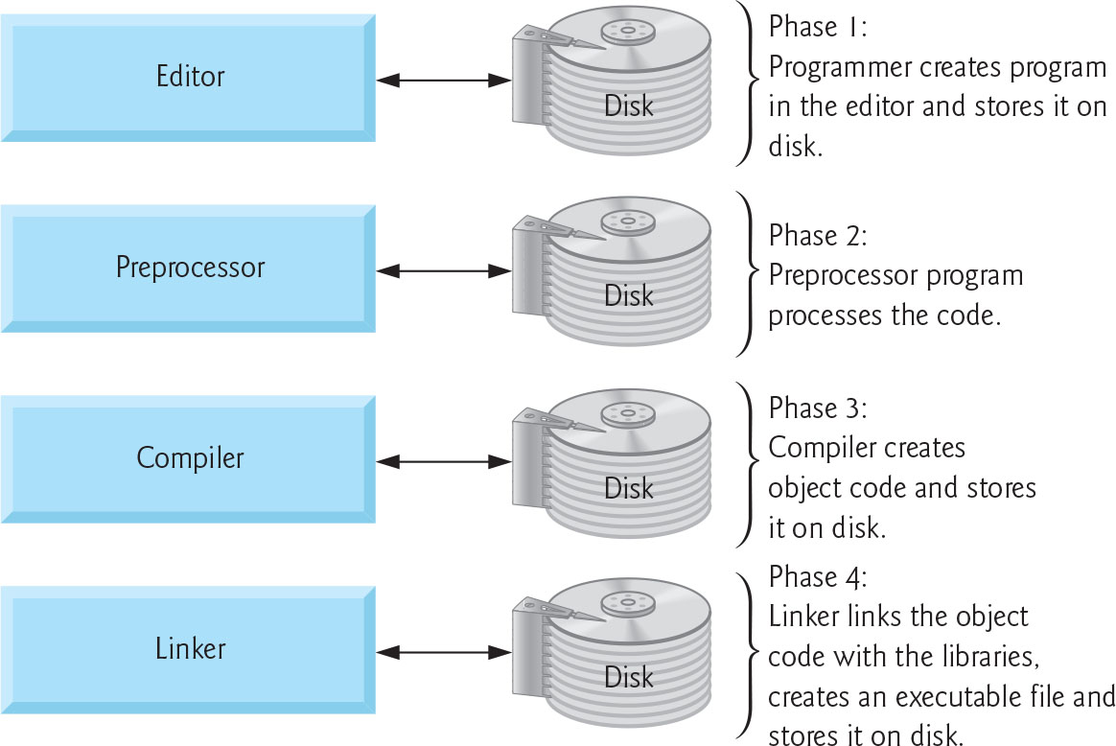
Figure 6 Typical C Development Environment (1 of 2)

Slide 61
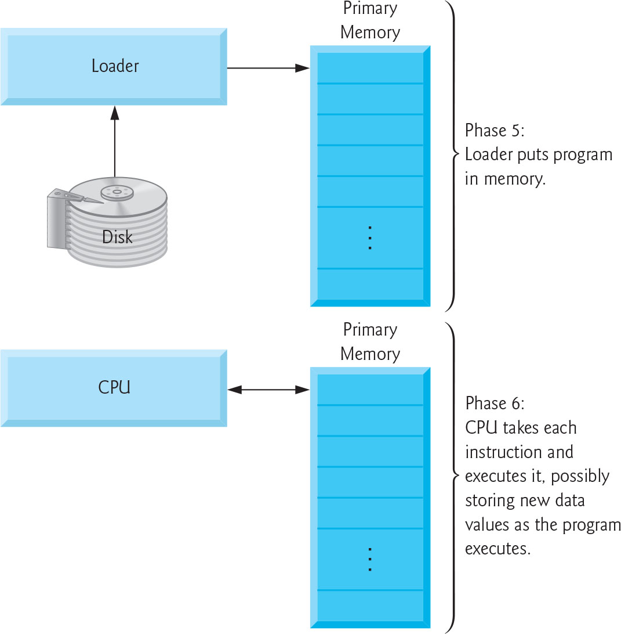
Figure 6 Typical C Development Environment (2 of 2)

Slide 62
Phase 4: Linking (1 of 2)
The next phase is called linking.
C programs typically contain references to functions defined elsewhere, such as in the standard libraries or in the private libraries of groups of programmers working on a particular project.
The object code produced by the C compiler typically contains “holes” due to these missing parts.
A linker links the object code with the code for the missing functions to produce an executable image (with no missing pieces).
On a typical Linux system, the command to compile and link a program is called g c c (the G N U compiler).

Slide 63

Phase 4: Linking (2 of 2)
To compile and link a program named welcome.c type
at the Linux prompt and press the Enter key (or Return key).
[Note: Linux commands are case sensitive; make sure that each c is lowercase and that the letters in the filename are in the appropriate case.]
If the program compiles and links correctly, a file called a.out is produced.
This is the executable image of our welcome.c program.

Slide 64
Phase 5: Loading
The next phase is called loading.
Before a program can be executed, the program must first be placed in memory.
This is done by the loader, which takes the executable image from disk and transfers it to memory.
Additional components from shared libraries that support the program are also loaded.

Slide 65
Phase 6: Execution
Finally, the computer, under the control of its C P U, executes the program one instruction at a time.
To load and execute the program on a Linux system, type ./a.out at the Linux prompt and press Enter.

Slide 66
Problems That May Occur at Execution Time
Programs do not always work on the first try.
Each of the preceding phases can fail because of various errors that we’ll discuss.
For example, an executing program might attempt to divide by zero (an illegal operation on computers just as in arithmetic).
This would cause the computer to display an error message.
You would then return to the edit phase, make the necessary corrections and proceed through the remaining phases again to determine that the corrections work properly.

Slide 67
Common Programming Error 1.1
Errors such as division-by-zero occur as a program runs, so they are called runtime errors or execution-time errors. Divide-by-zero is generally a fatal error, i.e., one that causes the program to terminate immediately without successfully performing its job. Nonfatal errors allow programs to run to completion, often producing incorrect results.

Slide 68
Standard Input, Standard Output and Standard Error Streams (1 of 2)
Most C programs input and/or output data.
Certain C functions take their input from stdin (the standard input stream), which is normally the keyboard, but stdin can be connected to another stream.
Data is often output to stdout (the standard output stream), which is normally the computer screen, but stdout can be connected to another stream.
When we say that a program prints a result, we normally mean that the result is displayed on a screen.

Slide 69
Standard Input, Standard Output and Standard Error Streams (2 of 2)
Data may be output to devices such as disks and printers.
There is also a standard error stream referred to as stderr.
The stderr stream (normally connected to the screen) is used for displaying error messages.
It’s common to route regular output data, i.e., stdout, to a device other than the screen while keeping stderr assigned to the screen so that the user can be immediately informed of errors.

